Slide 1



Pitch Presentation

Slide 2

WELCOME PINEWOOD COMMUNITY
PITCH PARTNERS!

Slide 3

Please join us to hear how your investment in the Monash Youth Music Festival was put to work!

Slide 4
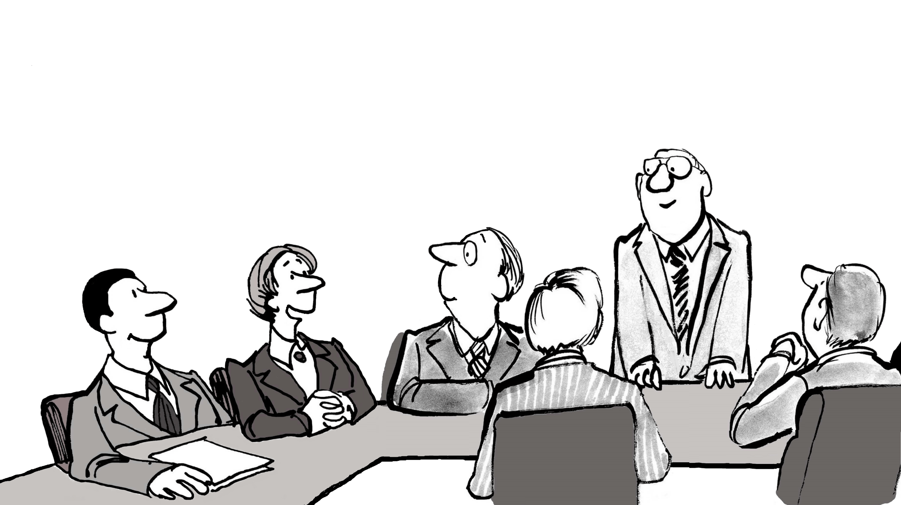
This year, with help from the Pitch Night funds, they ran five new sections called Mini Recitals!
Each section was non-competitive, and graded so every child would perform with others of similar standard.

Slide 5

To our surprise, 48 children, most of whom had never entered a music eisteddfod before, registered and performed on the day!

Slide 6
Joannes Roose, the director of the Melbourne Synfonia, adjudicated and ran wonderful music workshops after each mini recital.

Slide 7
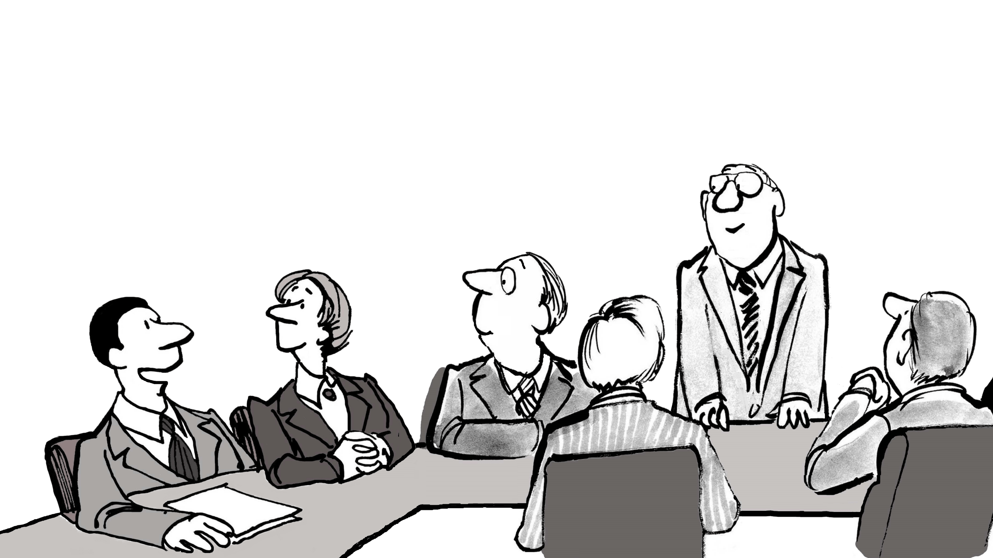
Every child performed beautifully, finishing with triumphant smiles and bows! Everyone went home on a high! They received a Certificate of Performance and an Adjudicator’s Report.

Slide 8
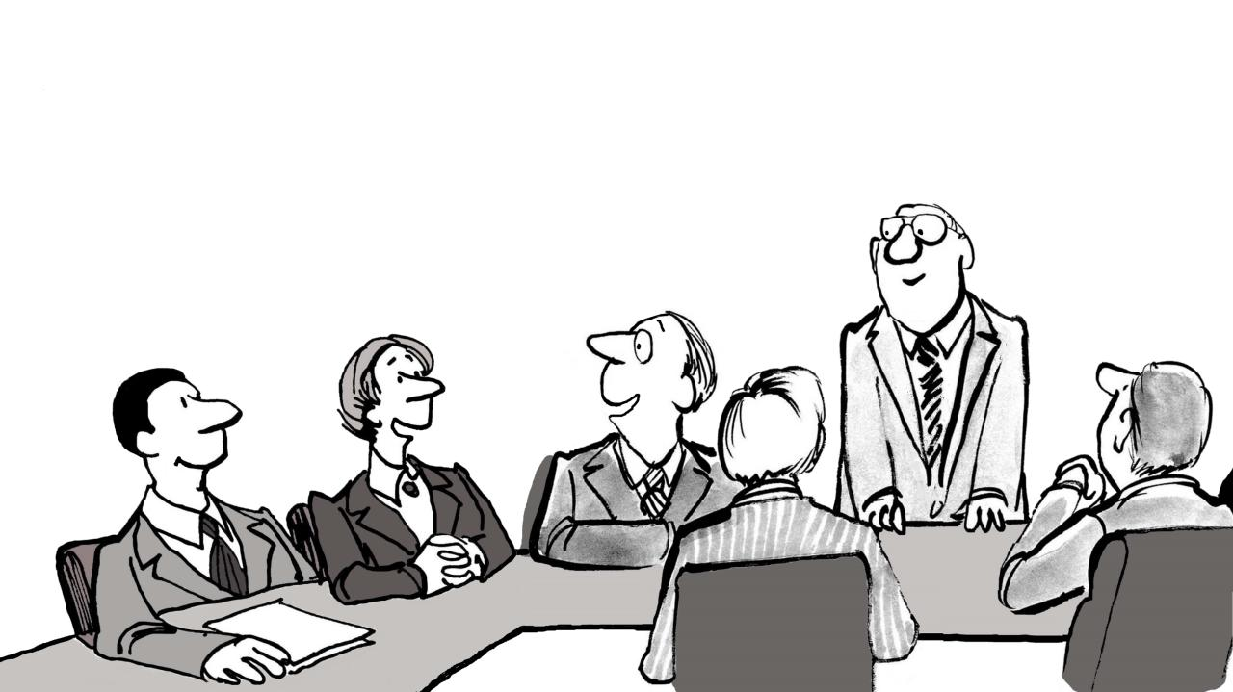
Parents said the experience was so wonderful they will definitely do it again next year!

Slide 9
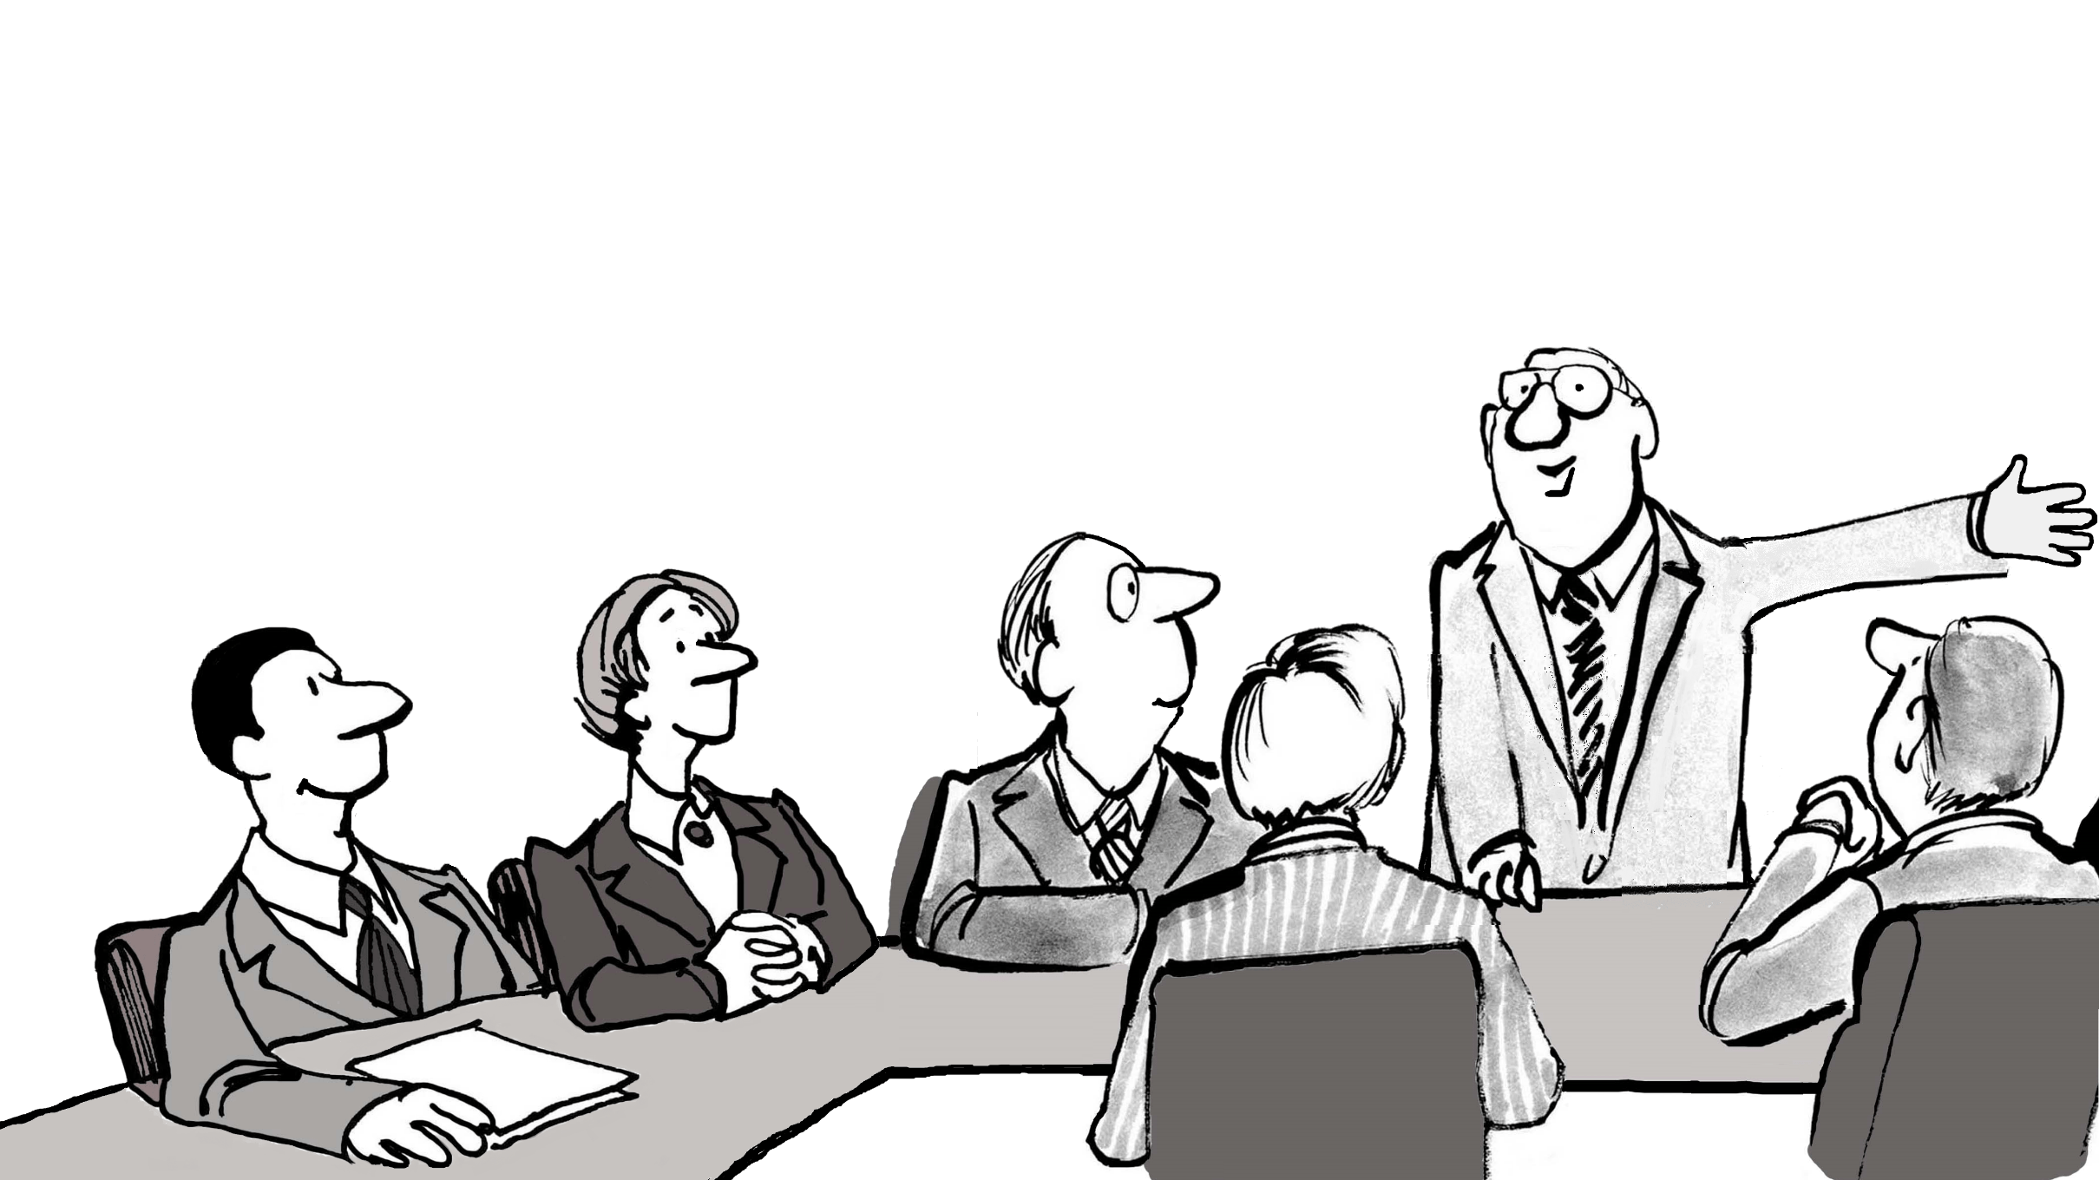

So they took away the fear of competition and replaced it with the joy of playing music!
Brilliant!
Monash Youth
Music Festival

Slide 10
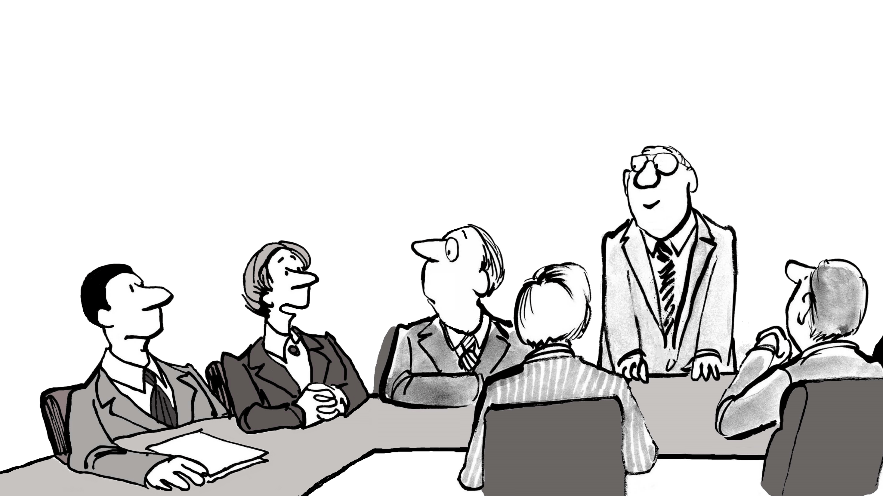
This is so important, as music builds confidence and self expression, and greatly enhances academic learning!

Slide 11
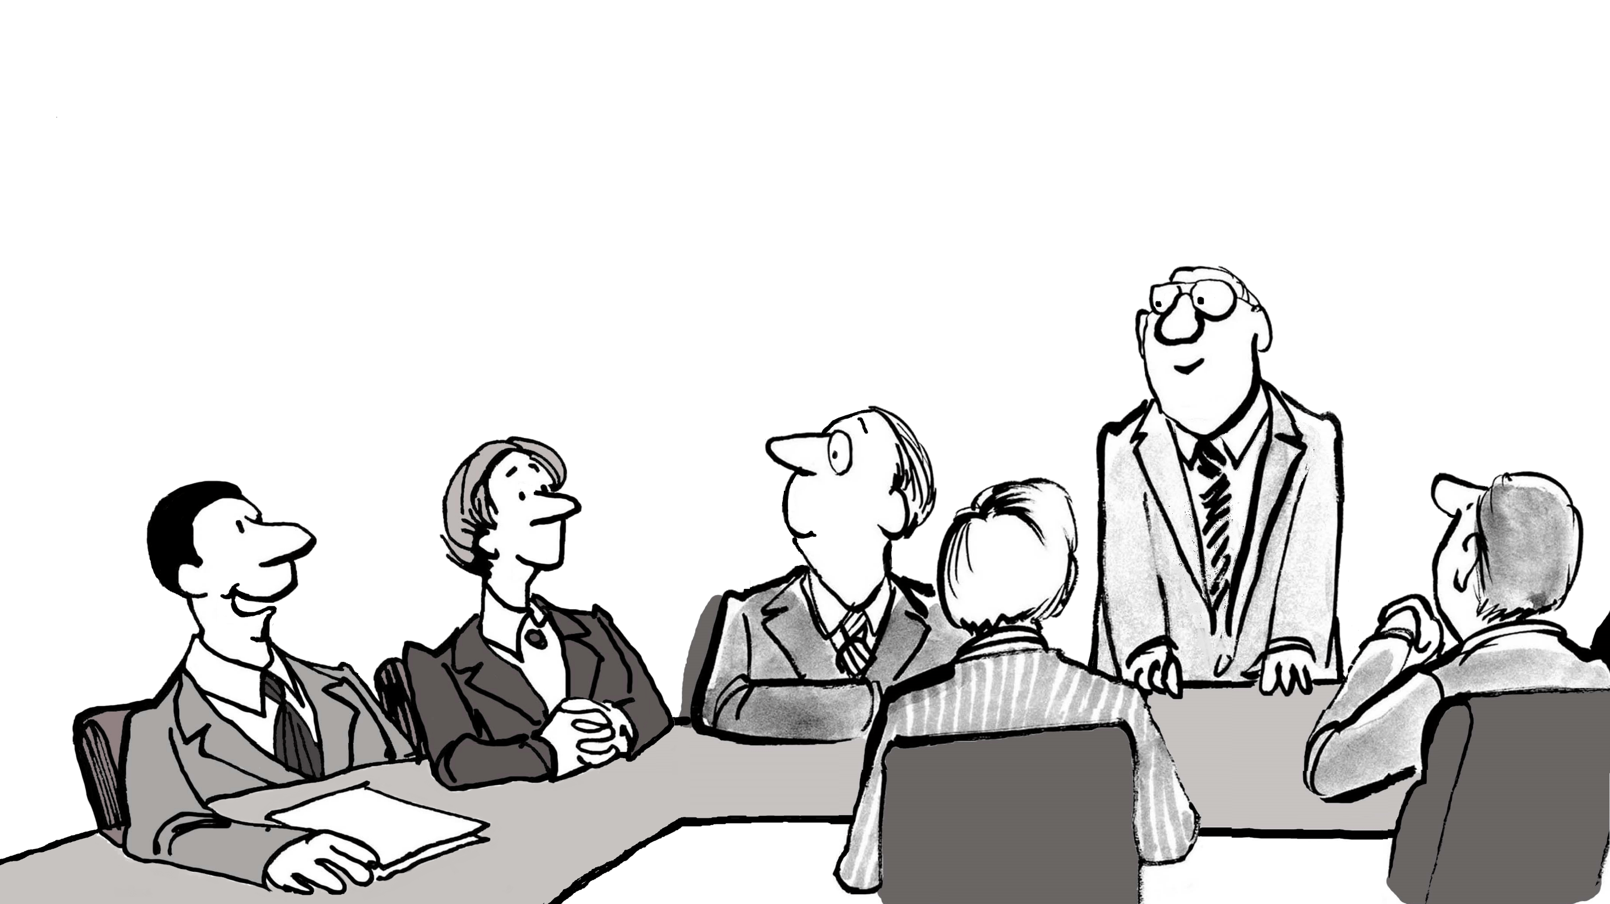
This is what the Ensembles Adjudicator had to say about the Festival…

Slide 12
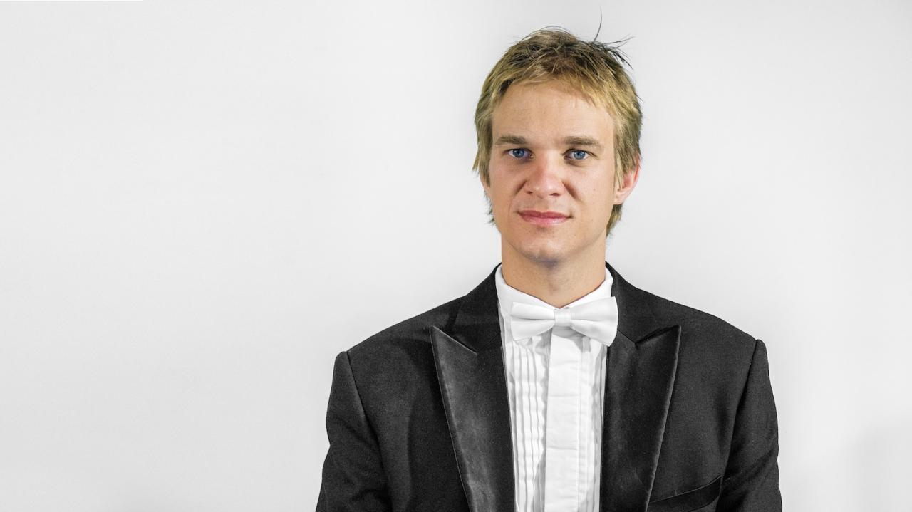
The Monash Youth Music Festival does an amazing job giving all children an opportunity to shine.
- Mario Dobernig, Ensembles Adjudicator at the 2018 MYMF

Slide 13
Today I saw the superstars of the future!
- Mario Dobernig, Ensembles Adjudicator at the 2018 MYMF

Slide 14

So thanks to the Pinewood Community Bank and our Pitch Partners, they were able to launch 5 new, fun and inclusive music events for kids of all standards.

Slide 15

And in return we receive…
Print advertising ✓
Sponsor’s Banners ✓
MC announcements ✓
MYMF Website ✓
Mention in e-News ✓

Slide 16
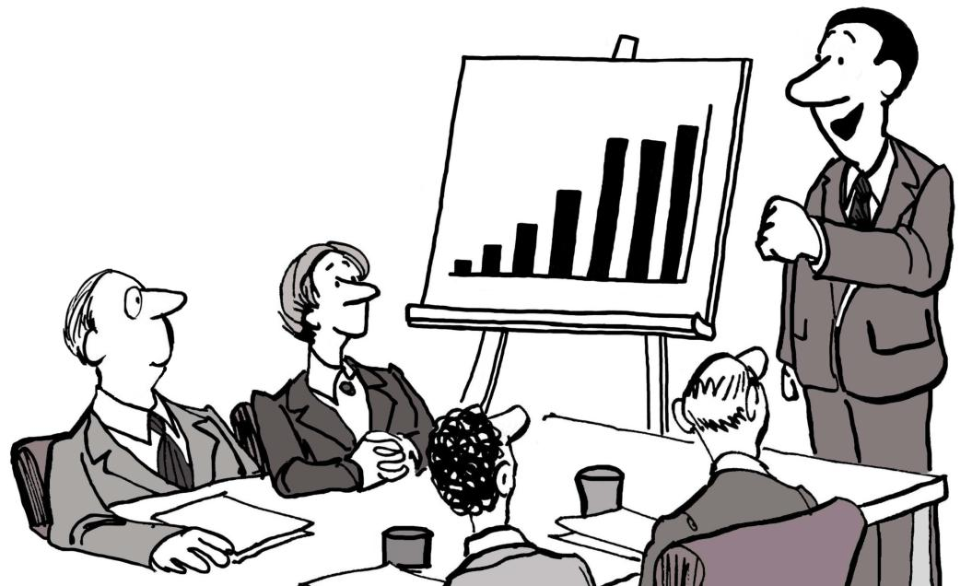
You might be surprised that Melbournians make over 14 million visits to popular live music performances in Melbourne’s pubs, clubs, bars, concert halls, music theatre and Festival venues per year.

Slide 17
This is more than DOUBLE the total visits (5.9 million) for all footy games, NRL, A-League and Super Rugby matches in Melbourne, plus the Spring Racing Carnival!

Slide 18

But so little is spent on “grass roots” music. And the Monash Youth Music Festival is only one of a very few eisteddfods left in Melbourne to support young musicians.

Slide 19
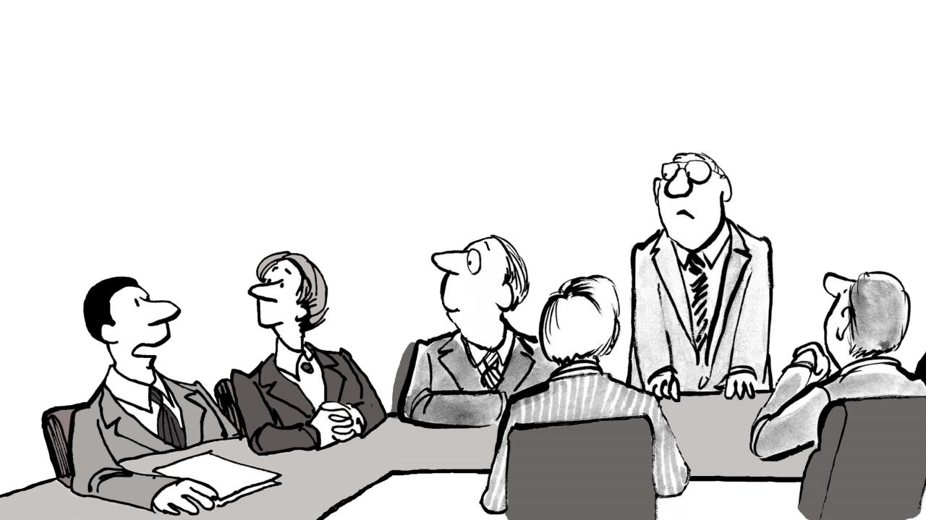
But they can’t continue without funding to pay for venue hire, music adjudicators, piano accompanists and printing costs!
Let’s keep this unique music festival alive!

Slide 20
Monash Youth
Music Festival

Slide 21
We wish to thank
★ Pinewood Community Bank® Branch of Bendigo Bank
and their Pitch Partners:
★ Mulgrave Country Club
★ Ryman Healthcare
★ Link Health
★ Signarama Mount Waverley
★ Elena Rullo CPA
★ Bedelis Lawyers
For their generous support
The Waverley Music Eisteddfod Inc. Committee,
organisers of the Monash Youth Music Festival™
Gordon Pyke, Yu Cheng, Stephanie Christie, John Wise, Beryl Nagorcka, Sue Lyons,
Jeff Blight, Rae Kum, Majella Drew, Wendy Wang, Ivy Yu and Judy Serelis
Royalty free cartoons ©123RF.com. Music courtesy Pianostreet.com. Voices created using naturalreaders.com
The Waverley Music Eisteddfod Inc. Committee, organisers of the Monash Youth Music Festival,
Gordon Pyke, Yu Cheng, Stephanie Christie, John Wise, Beryl Nagorcka, Sue Lyons, Jeff Blight, Rae Kum, Majella Drew, Wendy Wang, Ivy Yu and
Judy Serelis,
Wish to thank the Pinewood Community Bank® Branch of Bendigo Bank and their Pitch Partners
Mulgrave Country Club
Ryman Healthcare
Link Health
Signarama Mount Waverley
Elena Rullo CPA
and Bedelis Lawyers

